Slide 1
Introduction to Database
Lecture 1

Slide 2
Data vs Database
Data - The known facts that can be recorded and have implicit meaning.
For example: the name, telephone number and address of a person
Database – A collection of related data.
Mini World
Logically coherent collection of data
Specific purposed data
For example: Facebook Database, Amazon.com Database, University Database

Slide 3
Database Management System (DBMS) vs Database System
DBMS - A computerized system/software that enables users to create and maintain a database.
Definition
Construction
Manipulation
Sharing
Maintenance
Protection
Database System – The DBMS software with the data itself. Sometimes the applications are also involved.

Slide 4
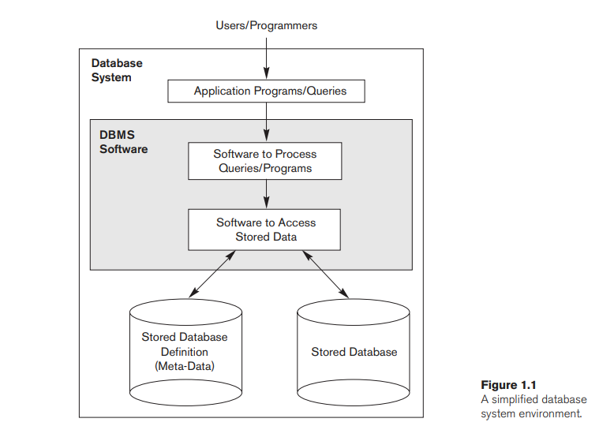

Slide 5
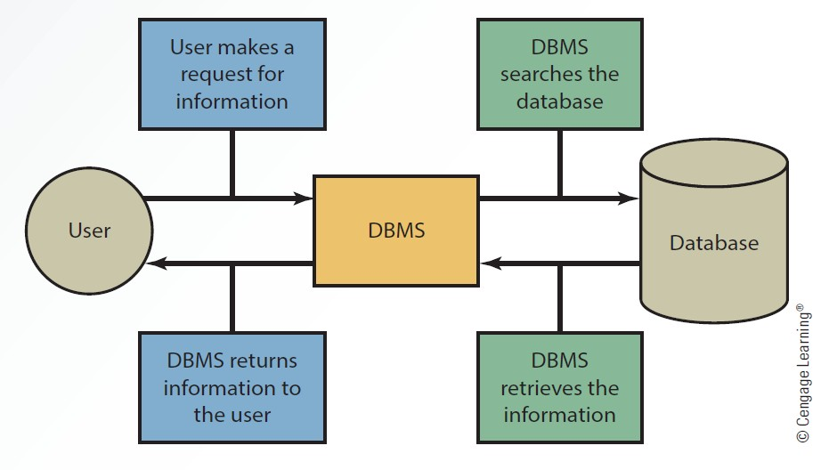

Slide 6
Example
University Database
Entities
Student
Course
Section
Grade Report
Prerequisite

Slide 7
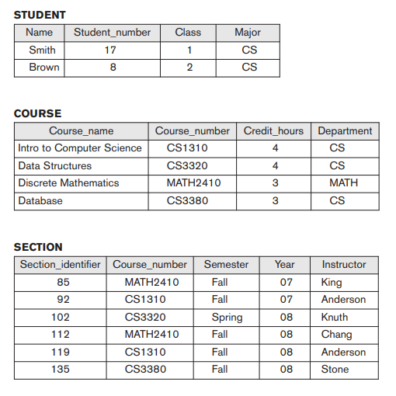
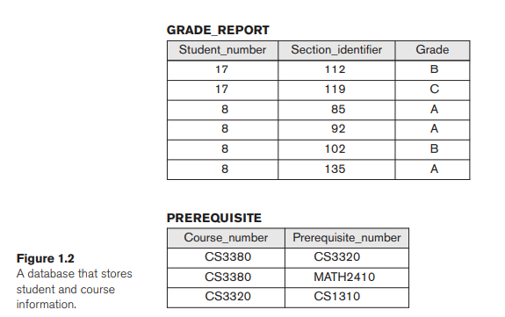

Slide 8
Designing of a DBMS
Requirements Specification and Analysis
Conceptual Design
Logical Design
Physical Design

Slide 9
Characteristics of the Database Approach
Self describing nature of a database system
Insulation between programs and data, and data abstraction
Support of multiple views of the data
Sharing of data and multiuser transaction processing

Slide 10
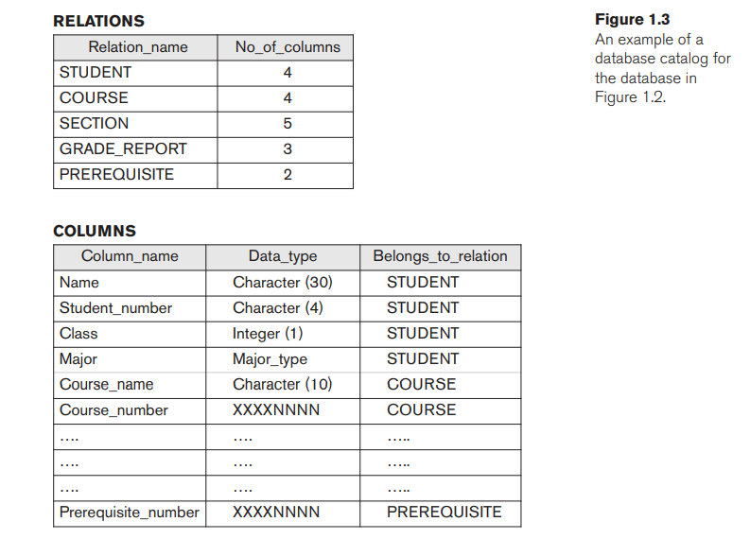

Slide 11
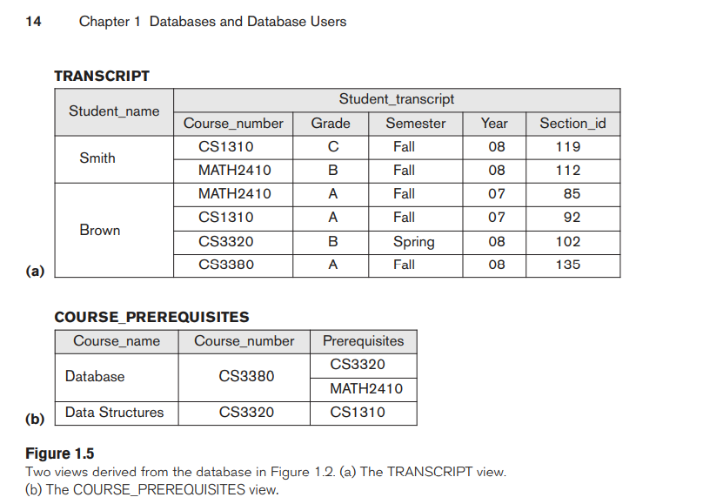

Slide 12
Database Users
Actors on the Scene – Those who actually use and control the database content, and those who design, develop and maintain database application
Database Administrators
Database Designers
End Users
Casual end users
Naïve end users
Sophisticated end users
Standalone users

Slide 13
Database Users
Actors behind the scene – Those who design and develop the DBMS software and related tools, and the computer systems operators
DBMS system designers and implementers
Tool developers
Operators and maintenance personnel

Slide 14
Advantages of DBMS
Controlling Redundancy
Restricting Unauthorized Access
Providing Persistent Storage for Program Objects
Providing Storage Structures and Search Techniques for Efficient Query Processing
Providing Backup and Recovery

Slide 15
Advantages of DBMS
Providing Multiple User Interfaces
Representing Complex Relationships among Data
Enforcing Integrity Constraints
Permitting Interfacing and Actions Using Rules and Triggers
Additional Implications of Using the Database Approach

Slide 16
Data Abstraction and Data Model
Data Abstraction – The suppression of detail of data organization and storage, and the highlighting of the essential features for an improved understanding of data.
Data Model – A collection of concepts that can be used to describe the structure of a database, and provides the necessary means to achieve the data abstraction.

Slide 17
Categories of Data Models
Conceptual Data Models – High-level models provide concepts that are close to the way many users perceive data.
Entity Relationship Models
Physical Data Models – Low-level models provide concepts that describe the details of how the data is stored on the computer storage media.
Representational Data Models – Implementation models which are between conceptual and physical models.
Relational Data Models

Slide 18
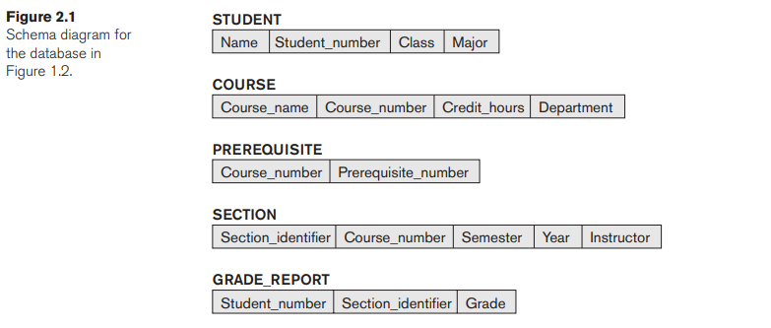
Schemas
Schema - The descriptions of a database, which is specified during database design.

Slide 19
The Three-Schema Architecture
The ANSI/SPARC (American National Standards Institute/Standards Planning And Requirements Committee) proposed it is 1978, which is to separate the user application from the physical database.
Levels of Architecture:
Internal Level
Conceptual Level
External Level

Slide 20
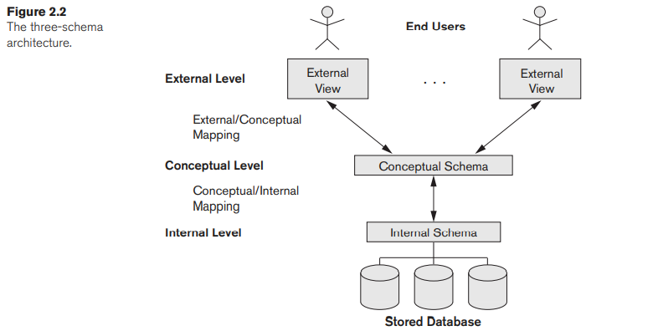

Slide 21
Data Independence
The capacity to change the schema at one level of a database system without having to change the schema at the next higher level.
Logical Data Independence
Physical Data Independence

